Slide 1
Exploring Data with Graphs
Prof. Andy Field

Slide 2
Aims
How to present data clearly
Introduce ggplot2
Graphs
  Scatterplots
  Histograms
  Boxplots
  Error bar charts
  Line graphs

Slide 3
The Art of Presenting Data
Graphs should (Tufte, 2001):
  Show the data.
  Induce the reader to think about the data being presented (rather than some other aspect of the graph).
  Avoid distorting the data.
  Present many numbers with minimum ink.
  Make large data sets (assuming you have one) coherent.
  Encourage the reader to compare different pieces of data.
  Reveal data.

Slide 4
Why Is This Graph Bad?

Slide 5
Why Is This Graph Better?

Slide 6
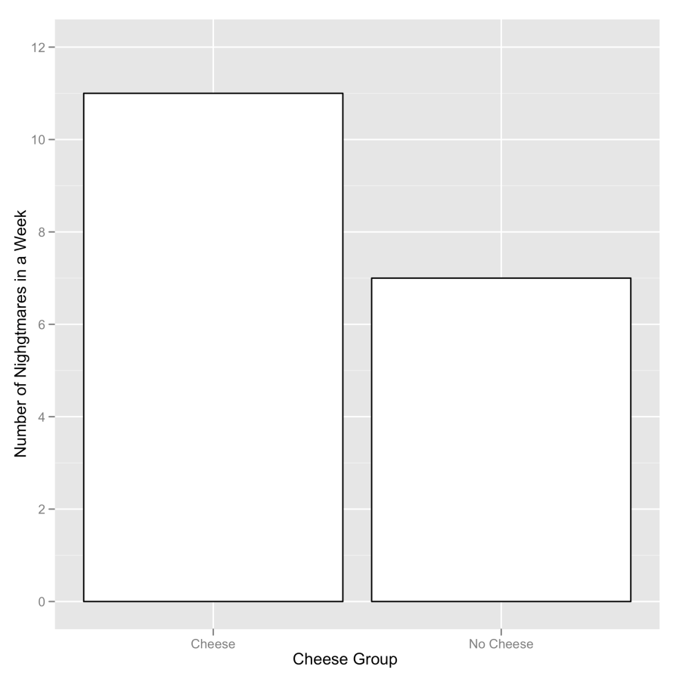
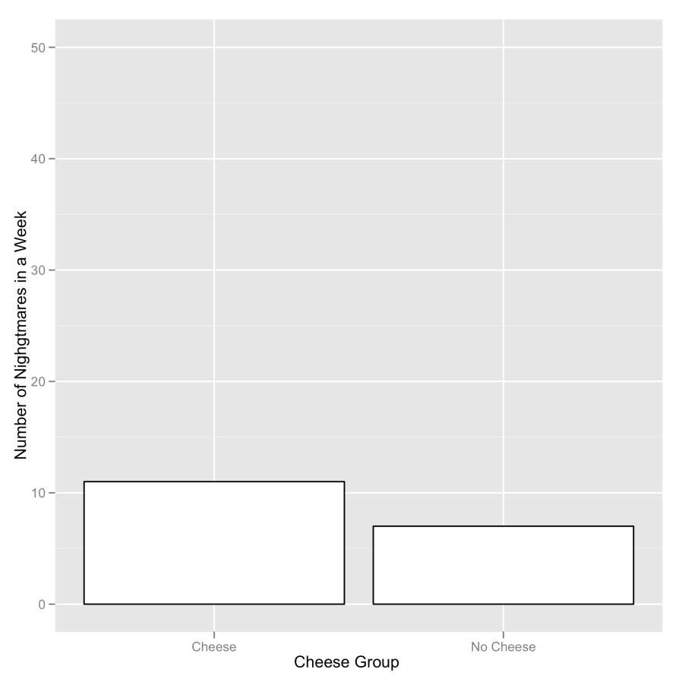
Deceiving the Reader
Two graphs about cheese

Slide 7
ggplot2
In ggplot2 a plot is made up of layers.

Slide 8
The anatomy of a graph

Slide 9
Specifying aesthetics in ggplot2

Slide 10
Scatterplots: Example
Anxiety and exam performance
Participants:
  103 students
Measures
  Time spent revising (hours)
  Exam performance (%)
  Exam Anxiety (the EAQ, score out of 100)
  Gender

Slide 11
Simple Scatterplot
  scatter <- ggplot(examData, aes(Anxiety, Exam))
  scatter + geom_point() + geom_smooth() labs(x = "Exam Anxiety", y = "Exam Performance %")

Slide 12
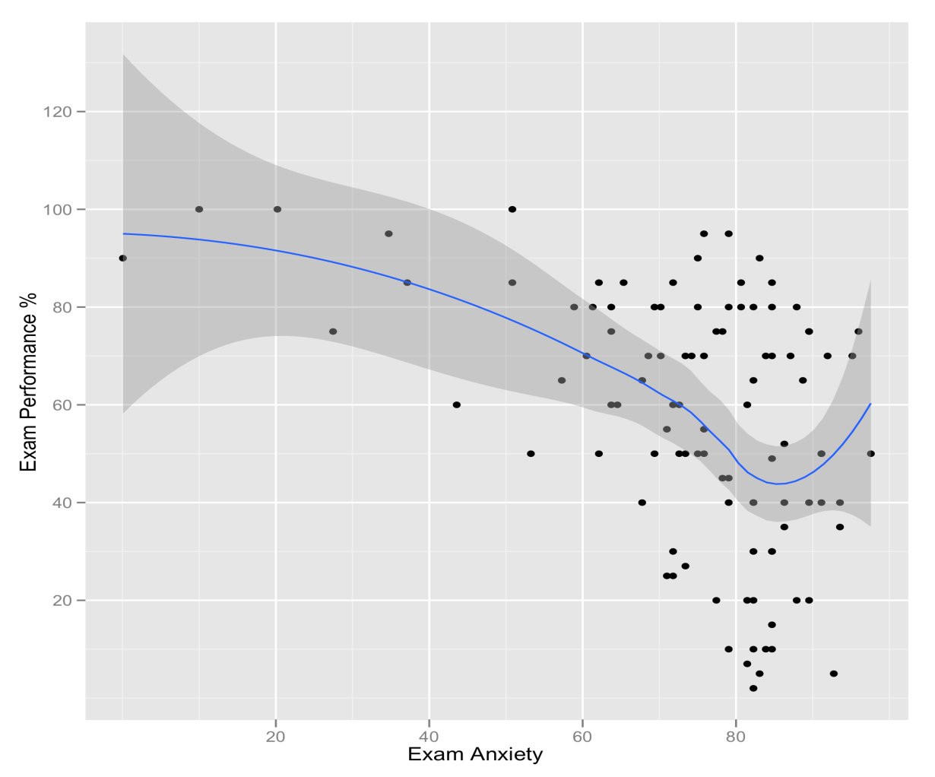
Simple Scatterplot
Scatterplot of exam anxiety against exam performance with a smoother added

Slide 13
Simple Scatterplot With Regression Line
  scatter <- ggplot(examData, aes(Anxiety, Exam))
  scatter + geom_point() + geom_smooth(method = "lm", colour = "Red")+ labs(x = "Exam Anxiety", y = "Exam Performance %")

Slide 14
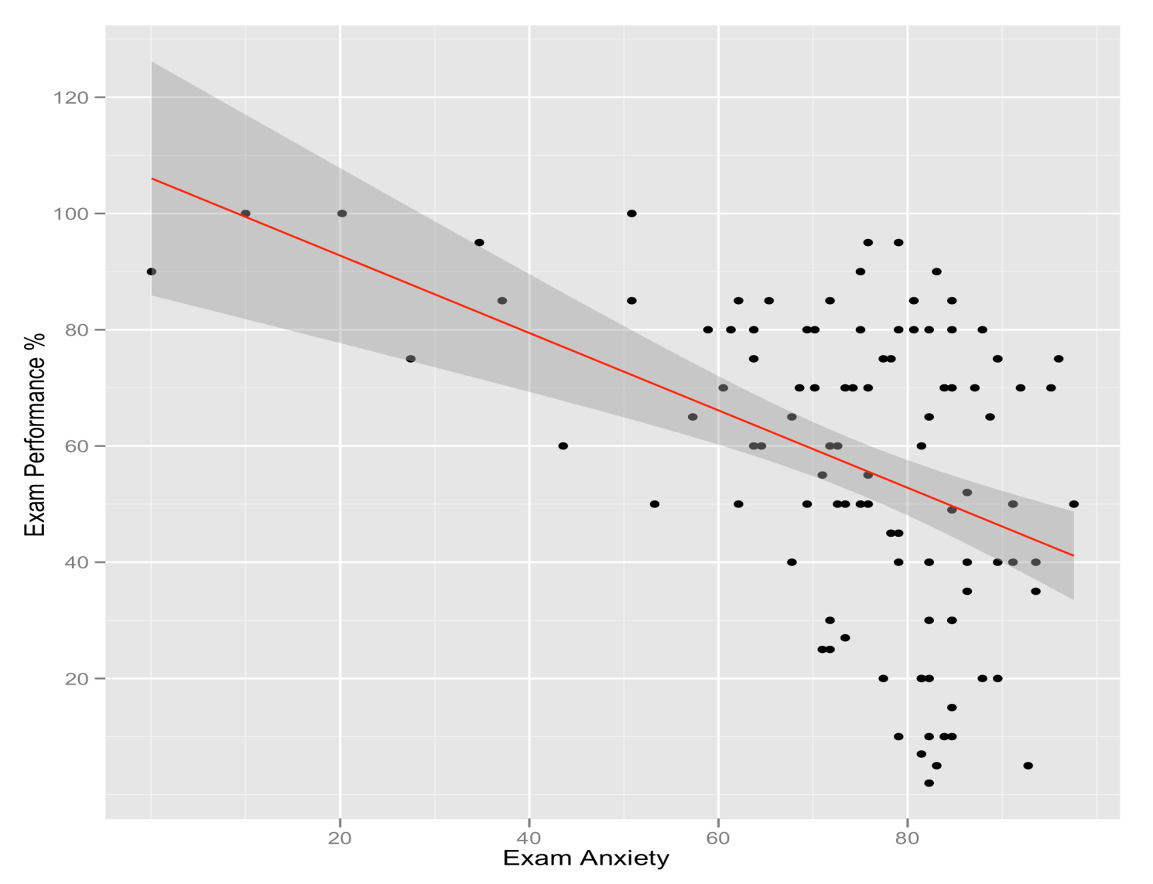
Simple Scatterplot
A simple scatterplot with a regression line added

Slide 15
Grouped Scatterplot
  scatter <- ggplot(examData, aes(Anxiety, Exam, colour = Gender))
  scatter + geom_point() + geom_smooth(method = "lm", aes(fill = Gender), alpha = 0.1) + labs(x = "Exam Anxiety", y = "Exam Performance %", colour = "Gender")

Slide 16
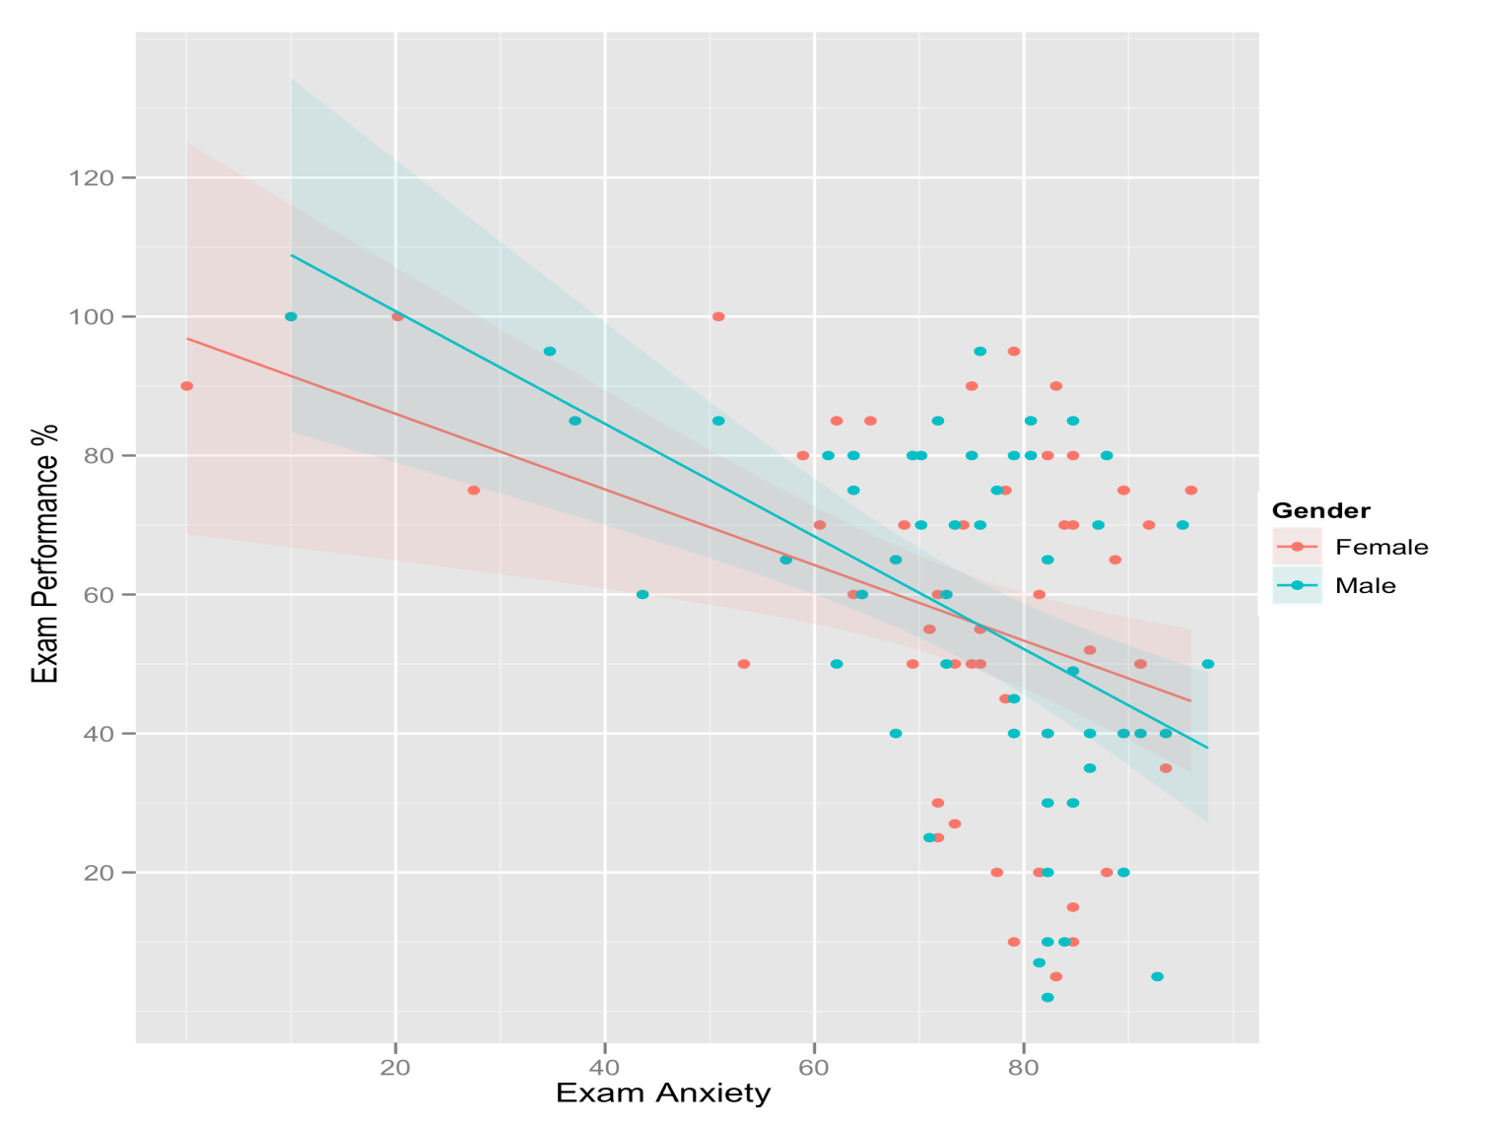
Grouped Scatterplot
Scatterplot of exam anxiety and exam performance split by gender

Slide 17
Histograms: Spotting Obvious Mistakes
Histograms plot:
  The score (x-axis)
  The frequency (y-axis)
Histograms help us to identify:
  The shape of the distribution
    Skew
    Kurtosis
    Spread or variation in scores
  Unusual scores

Slide 18
Histograms: Example
A biologist was worried about the potential health effects of music festivals.
Download Music Festival
Measured the hygiene of 810 concert-goers over the three days of the festival.
Hygiene was measured using a standardized technique :
  Score ranged from 0 to 4
    0 = you smell like a corpse rotting up a skunk’s arse
    4 = you smell of sweet roses on a fresh spring day

Slide 19
Histogram of Hygiene Scores for Day 1
Create the plot object:
  festivalHistogram <- ggplot(festivalData, aes(day1)) + opts(legend.position = "none")
Add the graphical layer:
  festivalHistogram + geom_histogram(binwidth = 0.4 ) + labs(x = "Hygiene (Day 1 of Festival)", y = "Frequency")

Slide 20
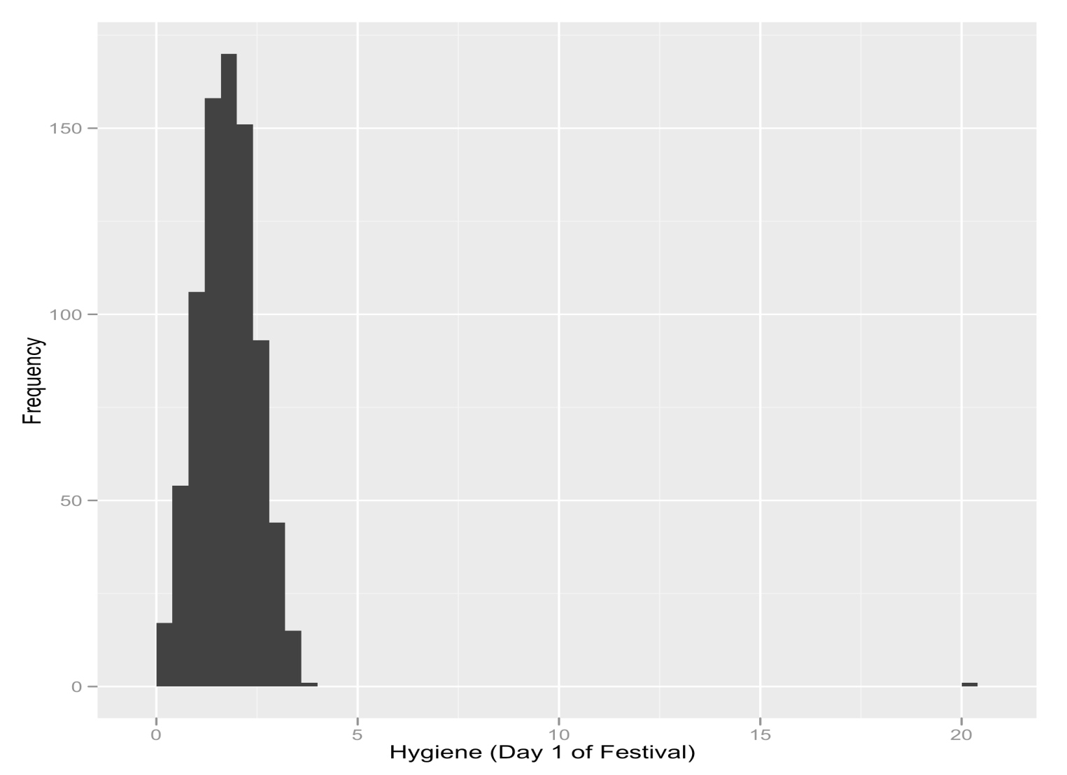
The Resulting Histogram

Slide 21
Boxplots (Box-Whisker Diagrams)
Boxplots are made up of a box and two whiskers.
The box shows:
  The median
  The upper and lower quartile
  The limits within which the middle 50% of scores lie.
The whiskers show
  The range of scores
  The limits within which the top and bottom 25% of scores lie

Slide 22
Boxplots (Box-Whisker Diagrams)
To make a boxplot of the day 1 hygiene scores for males and females, set the variable Gender as an aesthetic.
Specify Gender to be plotted on the x-axis, and hygiene scores (day1) to be the variable plotted on the y-axis:
  festivalBoxplot <- ggplot(festivalData, aes(gender, day1))
  festivalBoxplot + geom_boxplot() + labs(x = "Gender", y = "Hygiene (Day 1 of Festival)")

Slide 23
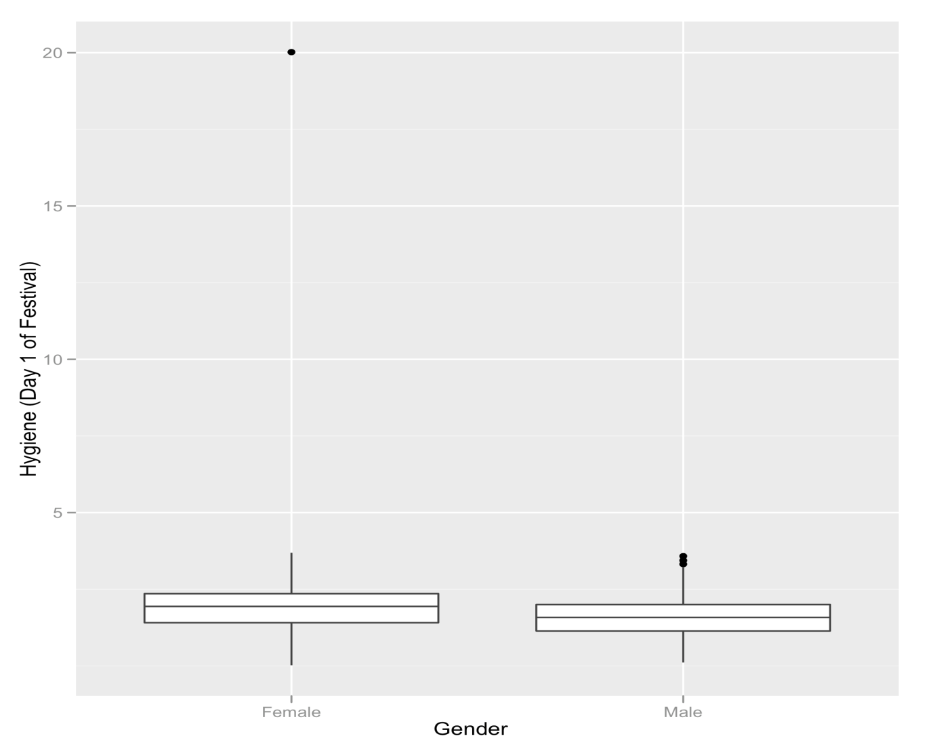
The Boxplot

Slide 24
What Does The Boxplot Show?

Slide 25
Error Bar Charts
The bar (usually) shows the mean score
The error bar sticks out from the bar like a whisker.
The error bar displays the precision of the mean in one of three ways:
  The confidence interval (usually 95%)
  The standard deviation
  The standard error of the mean

Slide 26
Bar Chart: One Independent Variable
Is there such a thing as a ‘chick flick’?
Participants:
  20 men
  20 women
Half of each sample saw one of two films:
  A ‘chick flick’ (Bridget Jones’s Diary),
  Control (Memento).
Outcome measure
  Physiological arousal as an indicator of how much they enjoyed the film.

Slide 27
Bar Chart: One Independent Variable
To plot the mean arousal score (y-axis) for each film (x-axis) first create the plot object:
  bar <- ggplot(chickFlick, aes(film, arousal))
To add the mean, displayed as bars, we can add this as a layer to bar using the stat_summary() function:
  bar + stat_summary(fun.y = mean, geom = "bar", fill = "White", colour = "Black"

Slide 28
Bar Chart: One Independent Variable
To add error bars, add these as a layer using stat_summary():
  + stat_summary(fun.data = mean_cl_normal, geom = "pointrange")
Finally, let’s add some nice labels to the graph using lab():
  + labs(x = "Film", y = "Mean Arousal")

Slide 29
Bar Chart: One Independent Variable
If we put all of these commands together we can create the graph by executing the following command:
  bar + stat_summary(fun.y = mean, geom = "bar", fill = "White", colour = "Black") + stat_summary(fun.data = mean_cl_normal, geom = "pointrange") + labs(x = "Film", y = "Mean Arousal")

Slide 30
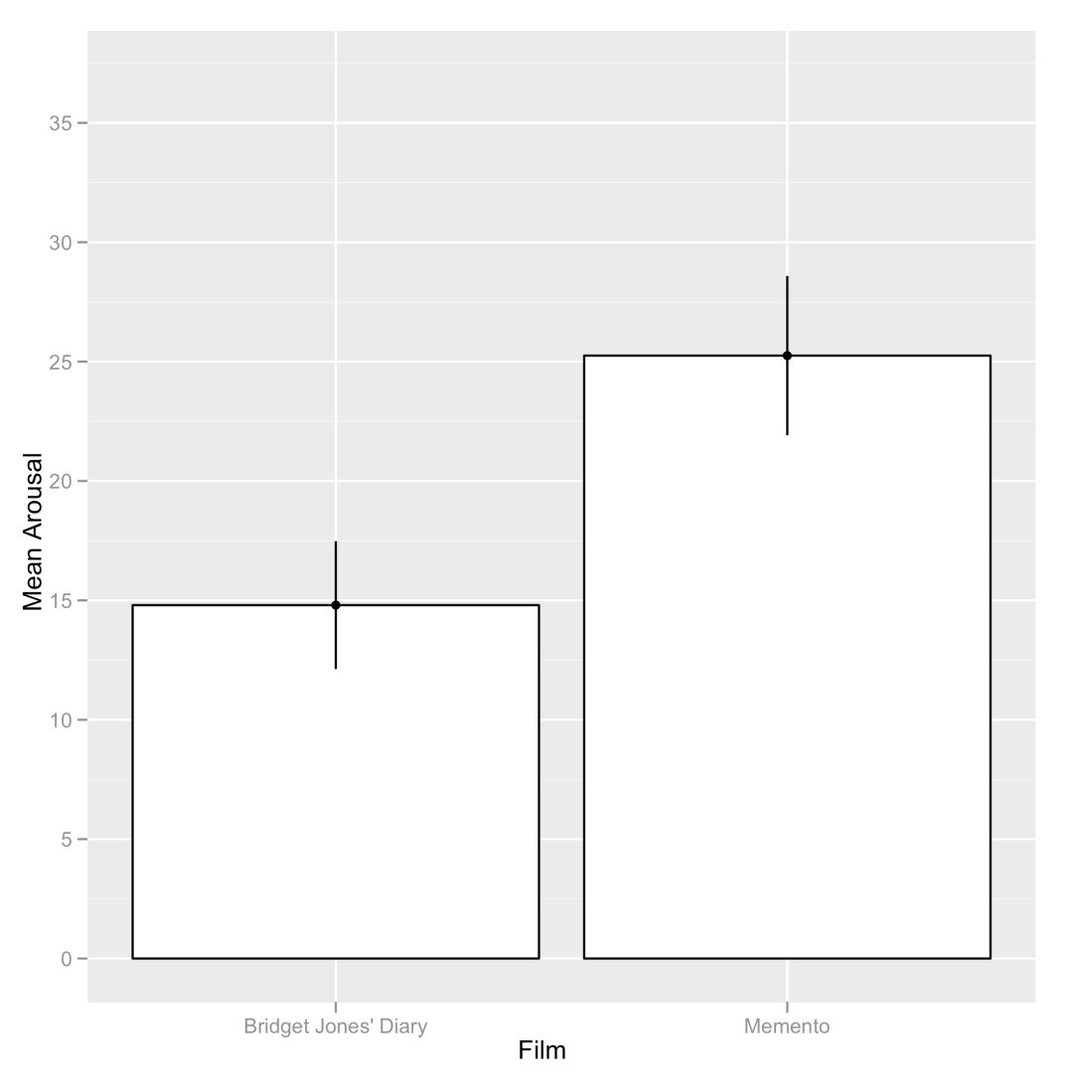
Bar Chart: One Independent Variable

Slide 31
Bar Chart: Two Independent Variables
  bar <- ggplot(chickFlick, aes(film, arousal, fill = gender))
  bar + stat_summary(fun.y = mean, geom = "bar", position="dodge") + stat_summary(fun.data = mean_cl_normal, geom = "errorbar", position = position_dodge(width = 0.90), width = 0.2) + labs(x = "Film", y = "Mean Arousal", fill = "Gender")

Slide 32
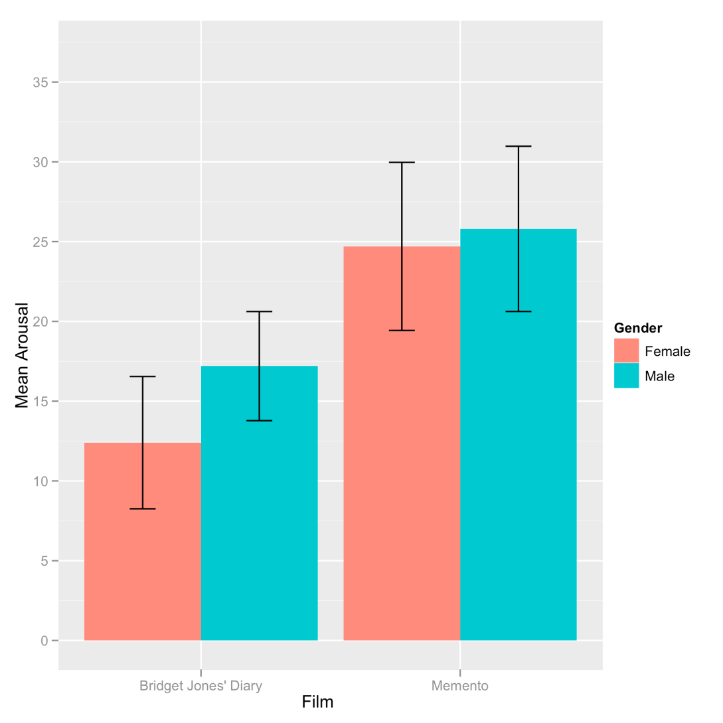
Bar Chart: Two Independent Variables

Slide 33
Bar Chart: Two Independent Variables
  bar <- ggplot(chickFlick, aes(film, arousal, fill = film))
  bar + stat_summary(fun.y = mean, geom = "bar") + stat_summary(fun.data = mean_cl_normal, geom = "errorbar", width = 0.2) + facet_wrap( ~ gender) + labs(x = "Film", y = "Mean Arousal") + opts(legend.position = "none")

Slide 34
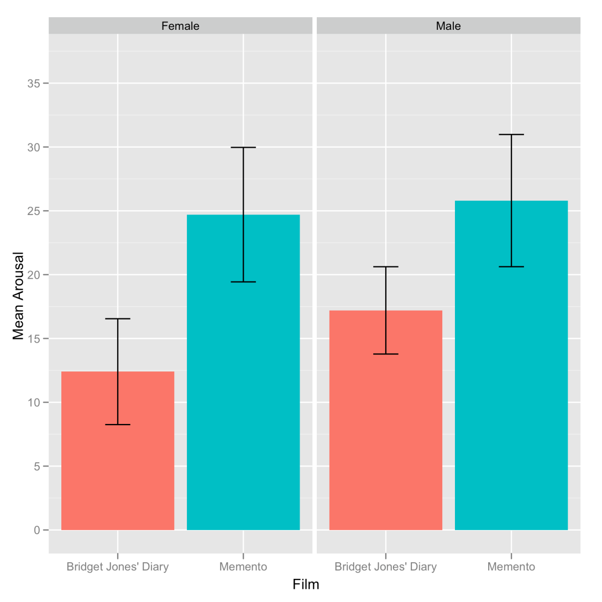
Bar Chart: Two Independent Variables

Slide 35
Line Graphs: One Independent Variable
How to cure hiccups?
Participants:
  15 hiccup sufferers
Each tries four interventions (in random order):
  Baseline
  Tongue-pulling manoeuvres
  Massage of the carotid artery
  Digital rectal massage
Outcome measure
  The number of hiccups in the minute after each procedure

Slide 36
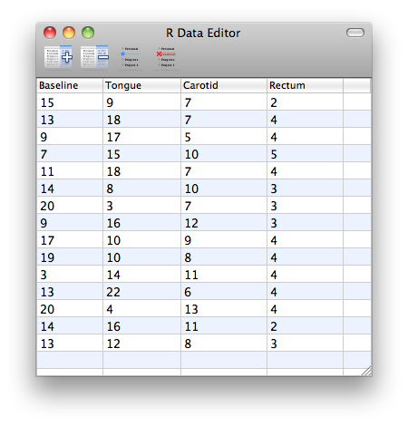

Slide 37
Line Graphs: One Independent Variable
These data are in the wrong format for ggplot2 to use.
We need all of the scores stacked up in a single column and then another variable that specifies the type of intervention.
We can rearrange the data as follows:
  hiccups<-stack(hiccupsData)
  names(hiccups)<-c("Hiccups","Intervention")

Slide 38
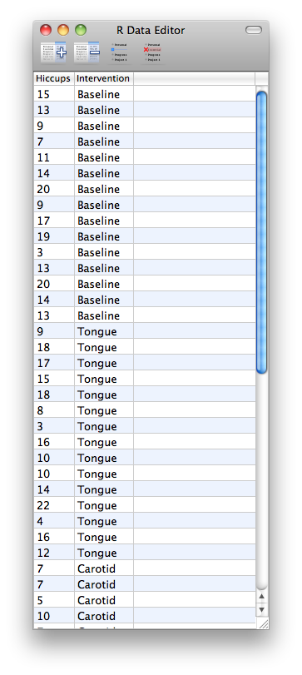

Slide 39
Line Graphs: One Independent Variable
To plot a categorical variable in ggplot() it needs to be recognized as a factor:
  Hiccups$Intervention_Factor <- factor(hiccups$Intervention, levels = hiccups$Intervention)

Slide 40
Line Graphs: One Independent Variable
We can then create the line graph by executing the following commands:
  line <- ggplot(hiccups, aes(Intervention_Factor, Hiccups))
  line + stat_summary(fun.y = mean, geom = "point") + stat_summary(fun.y = mean, geom = "line", aes(group = 1),colour = "Red", linetype = "dashed") + stat_summary(fun.data = mean_cl_boot, geom = "errorbar", width = 0.2) + labs(x = "Intervention", y = "Mean Number of Hiccups")

Slide 41
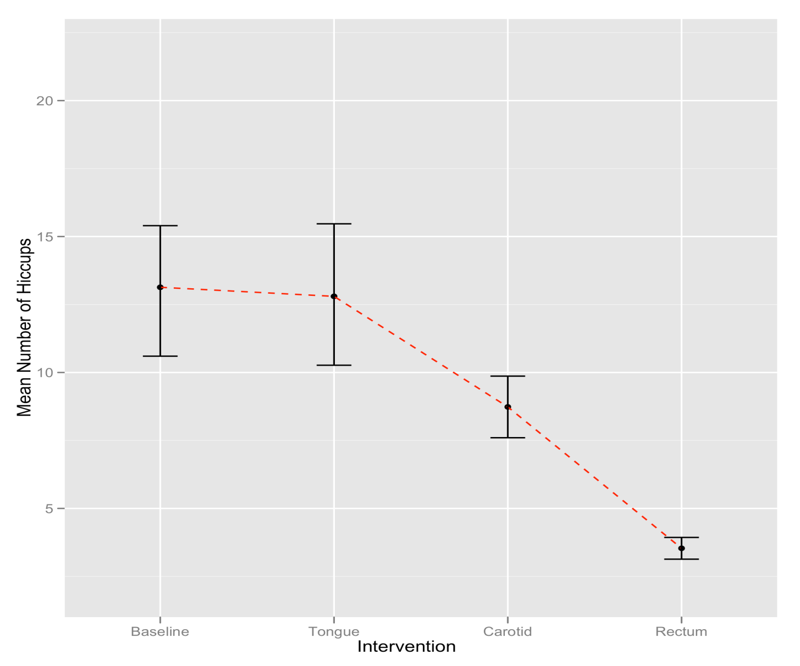
Line chart with error bars of the mean number of hiccups at baseline and after various interventions

Slide 42
Line Graphs for Several Independent Variables
Is text-messaging bad for your grammar?
Participants:
  50 children
Children split into two groups:
  Text-messaging allowed
  Text-messaging forbidden
Each child measures at two points in time:
  Baseline
  6 months later
Outcome measure
  Percentage score on a grammar test

Slide 43
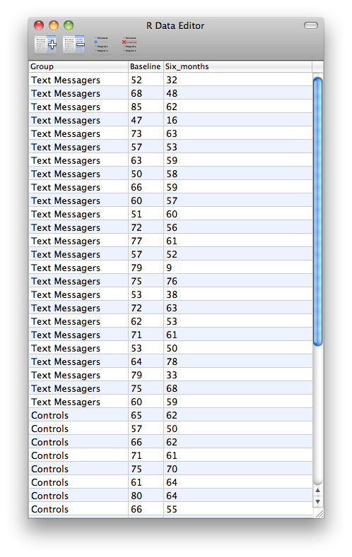

Slide 44
Line Graphs for Several Independent Variables
These data are again in ‘wide’ format but we need the data to be in ‘long’ format:
  textMessages<- melt(textData, id = "Group”, measured = c("Baseline", "Six_months”))
  names(textMessages)<-c( “Group”, “Time”, "Grammar_Score”)
We can now change the newly created variable Time so that it is treated as a factor, and provide labels for the two levels of this variable:
  textMessages$Time<-factor(textMessages$Time, labels = c("Baseline", "6 Months"))

Slide 45
Line Graphs for Several Independent Variables
  line <- ggplot(textMessages, aes(Time, Grammar_Score, colour = Group))
  line + stat_summary(fun.y = mean, geom = "point") + stat_summary(fun.y = mean, geom = "line", aes(group = Group)) + stat_summary(fun.data = mean_cl_boot, geom = "errorbar", width = 0.2) + labs(x = "Time", y = "Mean Grammar Score", colour = "Group")

Slide 46
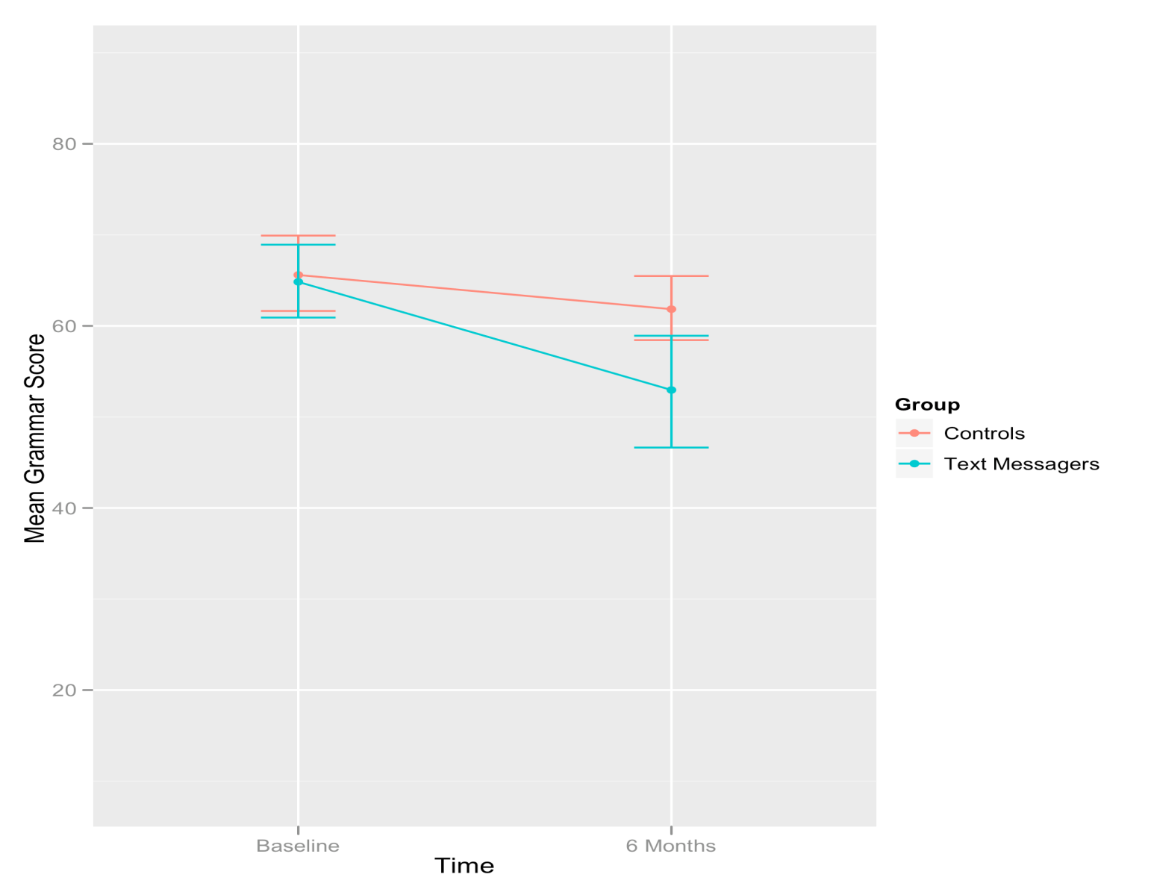
Error line graph of the mean grammar score over six months in children who were allowed to text-message versus those who were forbidden

